Slide 1
Application of Ensemble Models to Predict the Shear Strength of Concrete Beams Reinforced with Steel Fibres – Structural Health Monitoring Application
NANDITA SURESH KAMATH
2018B4A20868P

Slide 2
Project Objectives
Analysis of published literature
To build the pipeline of ML in each component that makes up SHM systems.
Analyze the different tools and algorithms used in ML processes for each level of SHM damage identification.
Implement Ensemble learning algorithms proposed for SHM dataset.

Slide 3
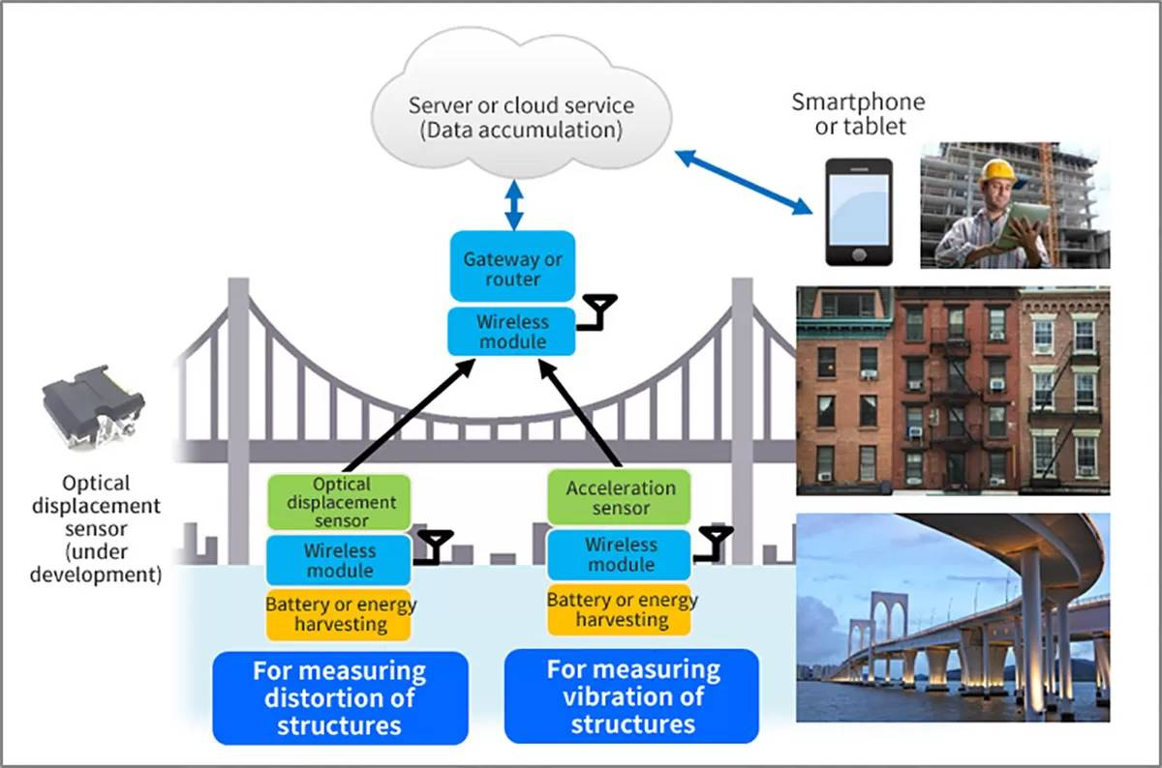
Structural Health Monitoring
The real-time observation and analysis of an engineering structure or system using measurement devices such as sensors. Sensitive features pertaining to the material, geometry, dynamic properties and responses of the structure can help to assess the current performance, document physiological changes and predict any potential damage in the structure.

Slide 4
Damage Identification
Detection (Existence of damage)
Location(Position of damage)
Extent (Severity of damage)
Prediction(Prognosis of damage)

Slide 5
SHM Methods
Traditional Methods
Model driven SHM – FEM Model
Data driven SHM – Machine Learning Approach

Slide 6
Traditional Methods
Visual Inspection
Ultrasonic Testing – Transducer emits high frequency sound waves and receiver collects reflection to detect damage
Acoustic Emission Testing – Analysis of sound waves emitted by structures under load
Magnetic Particle Testing – Applying magnetic field to a structure and introducing magnetic particles to find location of defect
Radiography – X-rays/Gamma rays
Thermography – Analysis of temperature changes using Infrared imaging
Strain Gauges – Sensors that measure strain under load
Load Cells – Sensors that measure the load on a structure

Slide 7
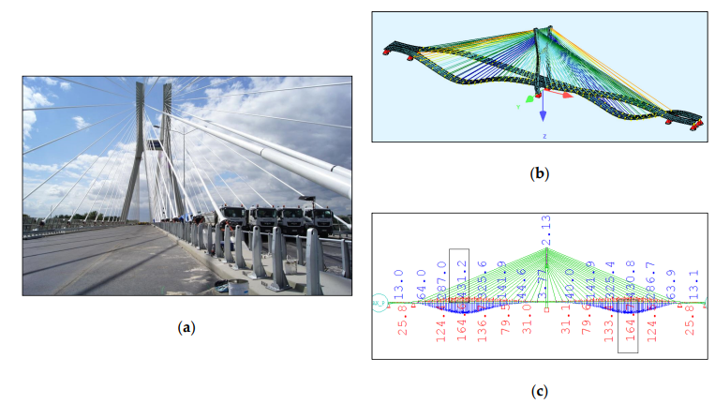
Model Driven SHM
Finite Element Method
The FEM is such an approximation method that subdivides a complex space or domain into a number of small, countable, and finite amount of pieces whose behavior can be described with comparatively simple equations (PDEs).

Slide 8
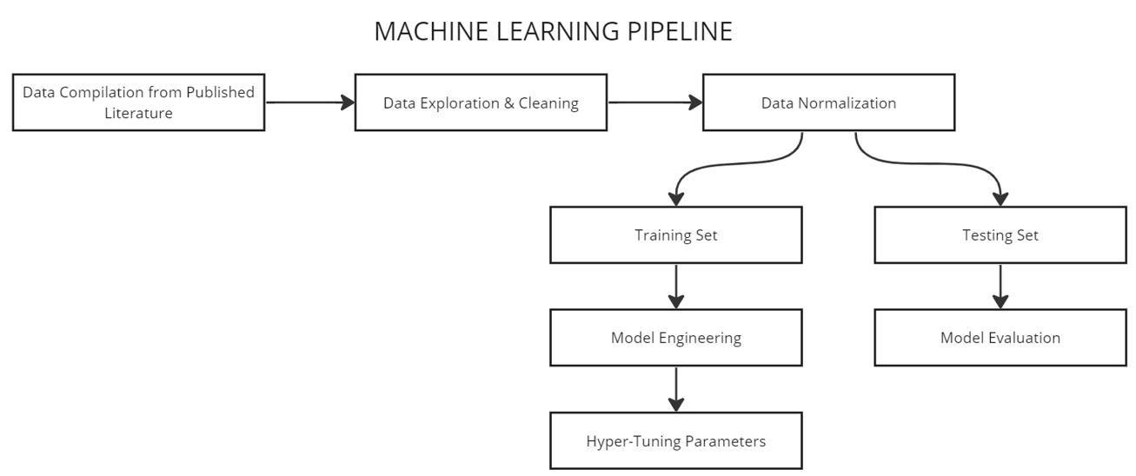
Data Driven SHM
Online damage assessment using sensors, real time data intake, cloud storage and ML powered prediction.
Application of ML to predict any feature that can help estimate the health of a structure

Slide 9
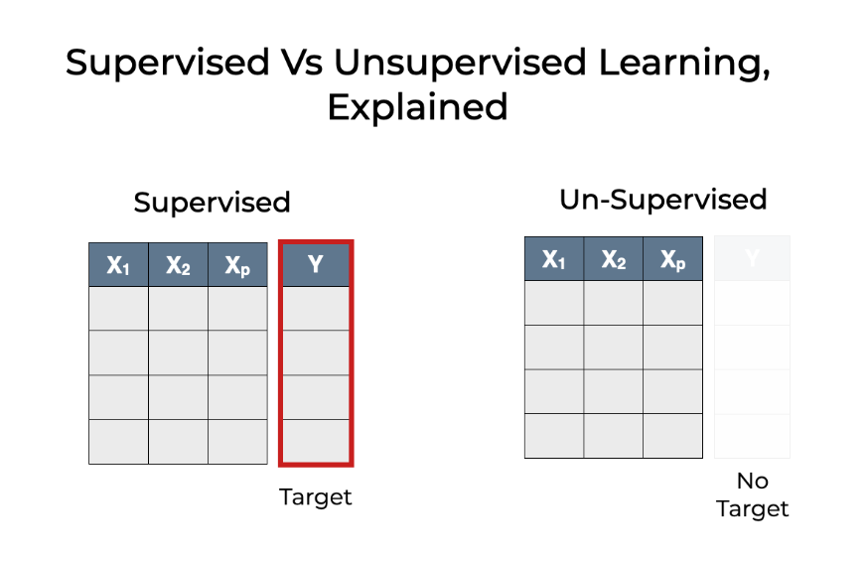
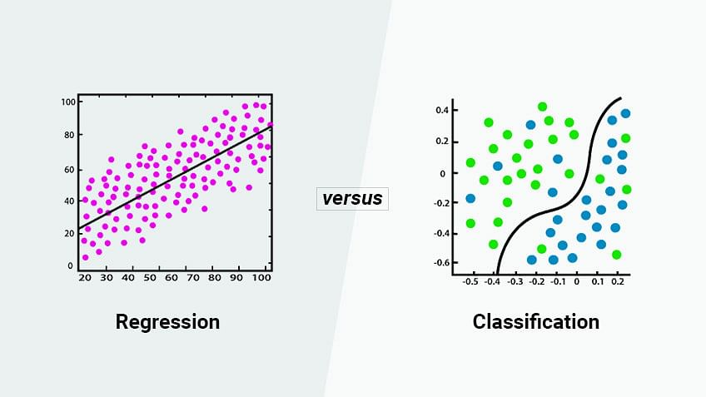
Determination of Learning Approach
1. Depending on nature of dataset
2. Depending on nature of target

Slide 10
End-to-End Model Development & Project Workflow
Ambient excitation for real structures (Bridge)
Local excitation -> no global response
Ongoing vehicles, changes in wind/water, seismic motion, shakers, direct impact etc
Traditional Methods – X rays, sound waves etc
SENSORS – Wireless, continuous measuring devices
Performance indicator of sensors – SENSITIVITY/DYNAMIC RANGE/ACCURACY/LINEARITY/STABILITY/RESPONSE TIME/LOCATION
Excitation Methods
Data Acquisition
Data Analysis
Model Development and Evaluation
Data Pre-processing
Selecting and Training Supervised ML algorithms
Calculate Mathematical Efficiency of Model to Estimate Performance:
Normalize data – different scales lead to slow convergence
Feature selection – reduce computation size
Split data (Train/Test or Random CV)
Make data – Usable/Reliable/Relevant
Statistical Data Analysis to gauge spread of data (Mean/Median/Range)
Data Wrangling to flag outliers
Updating any missing values and removing unwanted variables

Slide 11
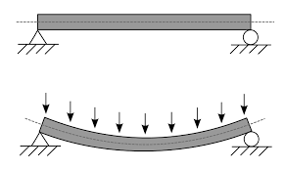
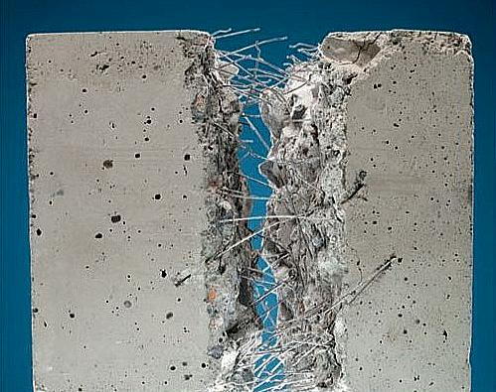
Application of Steel Fibers as Shear Reinforcement in Concrete Beams
Steel Fibre Network
Beam under uniformly
distributed load

Slide 12
Case Study
Dataset - Application of Steel Fibers as Shear Reinforcement in Concrete Beams
Beam Dimensions | Width of Beam
 | Height of Beam
 | Effective Depth of Beam
 | Shear span/Effective Depth Ratio
Concrete Dimensions | Cylinder Compressive Strength of Concrete
 | Yield Strength of Concrete
Steel Fiber Dimensions | Length of Steel Fiber
 | Diameter of Steel Fiber
 | Length/Diameter of steel fiber Ratio
 | Volume Fraction of Steel Fibers
Target Feature | Shear Stress as per Experiment

Slide 13
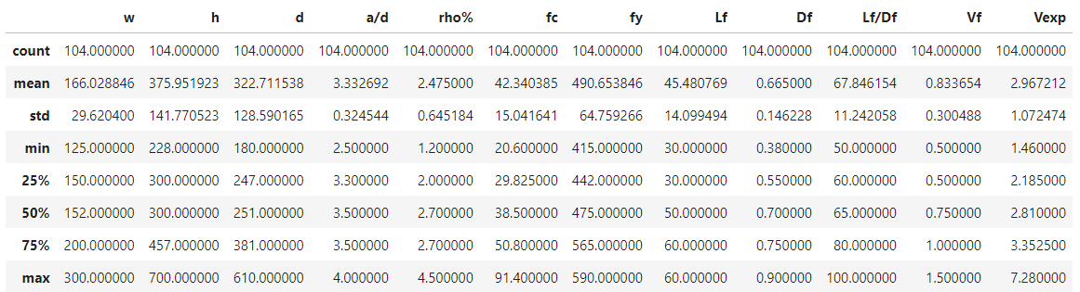
Data Pre-processing
Bring features to scale using Normalization
Encourage fast convergence of model

Slide 14
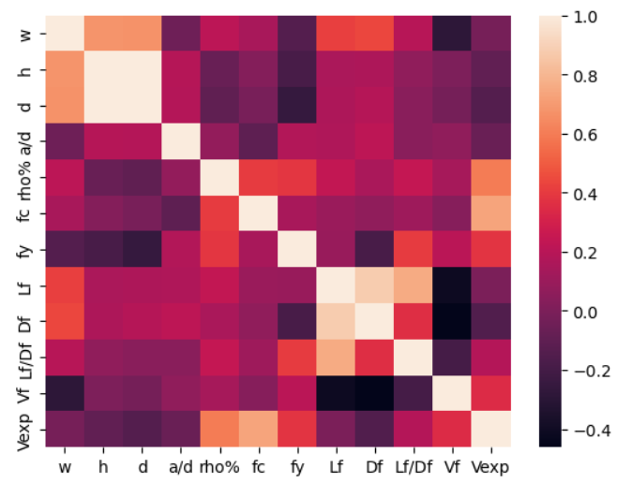
Correlation Matrix of Features
Person Correlation Constant (-1 to +1) to estimate Linear relation between features and target
A. M. S. M, "Genetic algorithm for predicting shear strength of steel fiber reinforced concrete beam with parameter identifictaion and sensitivity analysis," Journal of Building Engineering, 2020. , 2020.

Slide 15
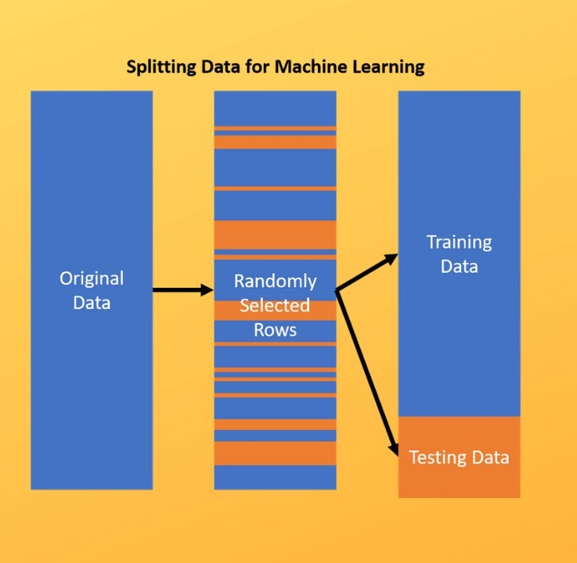

Data Pre-processing
Train/Test Split
Cross Validation

Slide 16
Ensemble Learning
Ensemble techniques combine individual ML models together to improve the stability and predictive power of the model.
Bagging
Boosting
Stacking
Decrease Variance
Decrease Bias
Improve Prediction

Slide 17
Why use multiple models?
Singular Models are Ineffective
Certain models do well in modeling one aspect of the data, while others do well in modeling another
Combine Results
Learn several simple models and combine their output to produce the final decision
This provides a composite prediction where the final accuracy is better than the accuracy of individual models
Improve Variance and Bias
The combined strength of the models offsets individual model variances and biases
Composite Accuracy

Slide 18
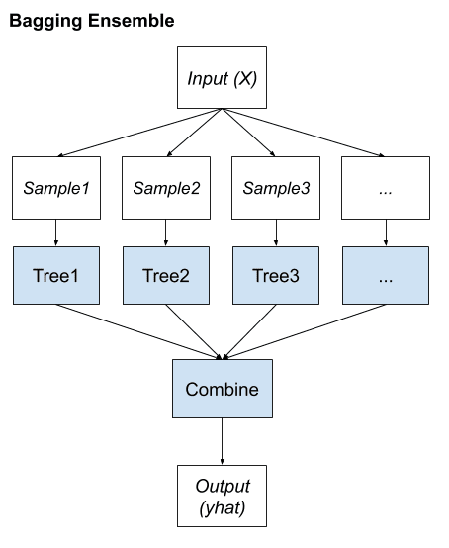
BAGGING
Bagging involves fitting many decision trees on different samples of the same dataset and averaging the predictions.
Key elements:
1. Bootstrap samples of the training dataset.
2. Unpruned decision trees fit on each sample.
3. Simple voting or averaging of predictions.

Slide 19
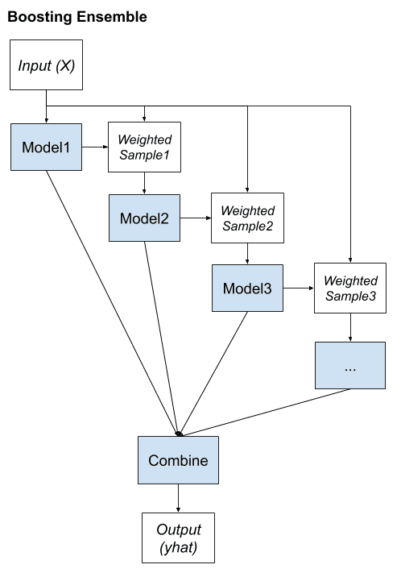
BOOSTING
Boosting involves adding ensemble members sequentially that correct the predictions made by prior models and outputs a weighted average of the predictions.
Key elements:
Bias training data toward those examples that are hard to predict.
Iteratively add ensemble members to correct predictions of prior models.
Combine predictions using a weighted average of models.

Slide 20
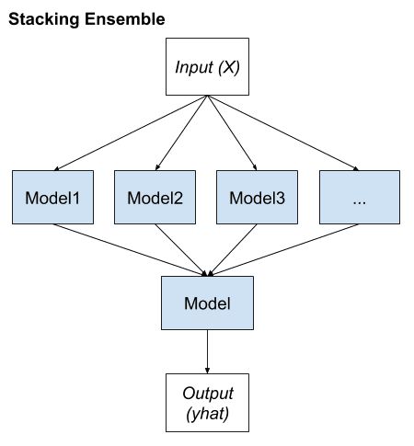
STACKING
Stacking involves fitting many different models types on the same data and using another model to learn how to best combine the predictions.
Key elements:
1. Unchanged training dataset.
2. Different machine learning algorithms for each ensemble member.
3. Machine learning model to learn how to best combine predictions.

Slide 21
VOTING
Voting involves fitting many different models types on the same data and using soft or hard voting to combine the predictions.
Key elements:
Different machine learning algorithms for each ensemble member on same training set
Hard Voting- Simple majority
Soft Voting- Probability of model scores

Slide 22
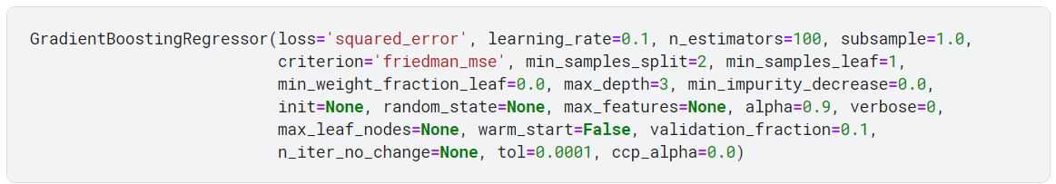

Hyper-Parameter Tuning
Parameters that are not directly learned by the estimator need to be tuned
User may pass the parameters as arguments to the constructor of the estimator class

Slide 23
Setting Parameters
Select best/optimum combination of parameters that result in best CV score
HPT search consists of:
Regressor
Parameter space
Method for sampling candidates
CV scheme
Scoring function

Slide 24
HPT Methods
GridSearchCV
RandomizedSearchCV
Exhaustively considers all parameter combinations for specified values
param_grid=[{‘C’:[1,10,100],
’kernel’:[‘linear’,’sag’]}]
Samples a given number of candidate values from a parameter space with a specified distribution
param_dist={‘l1_ratio’:stats.uniform(0,1), ‘alpha’:loguniform(1e-4,1e0),}

Slide 25
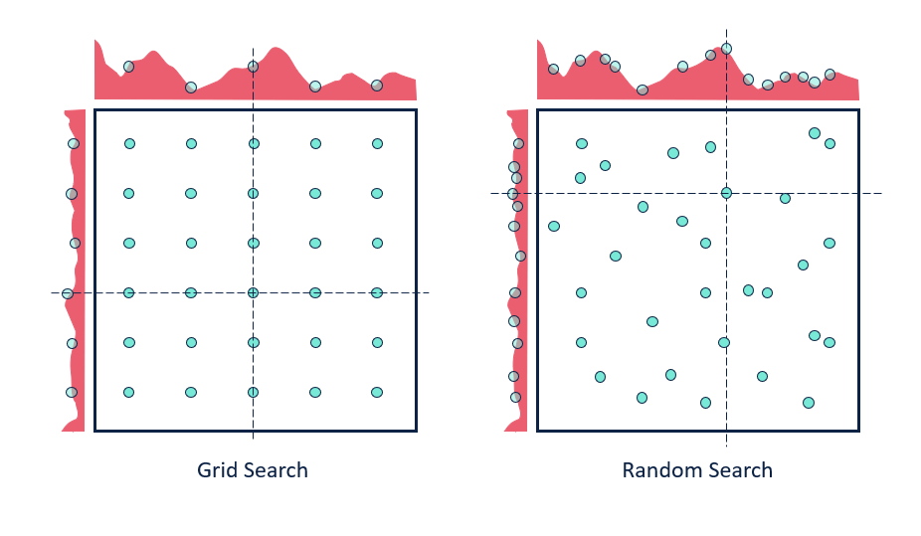

Slide 26
Logic for Model Building
Preliminary Model Tested | Accuracy
Linear Regression | 72%
Ridge | 72%
Lasso | 63%
Decision Trees | 69%
Ensemble Model - I | Accuracy
Bagging | 72%
Extra Trees | 81%
Random Forest | 74%
AdaBoost | 77%
Gradient Boosting | 83%
Ensemble Model - II | Accuracy
Stacking (Ridge, Linear SVM) | 72%
Voting (Ridge, Gradient Boosting, Decision Trees) | 81%

Slide 27
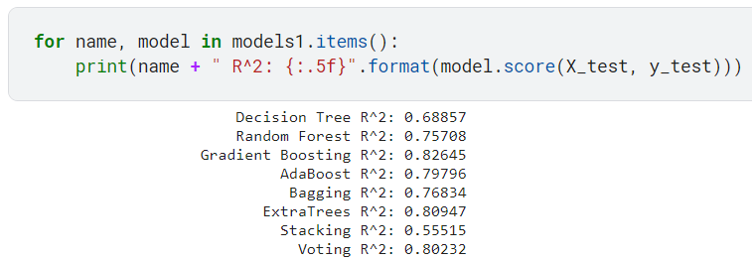
Model Training and Evaluation
 | Ensemble Models Tested | R2 Value
BAGGING | Bagging | 72%
 | Extra Trees | 81%
 | Random Forest | 74%
BOOSTING | AdaBoost | 77%
 | Gradient Boosting | 83%
OTHERS | Stacking | 55%
 | Voting | 80%

Slide 28
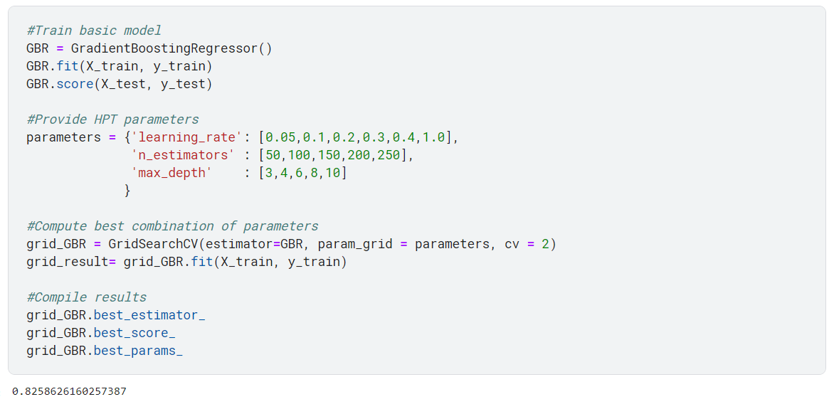
Optimised Algorithm

Slide 29
Conclusion

Slide 30
Future Work
Data simulation model on existing training set to increase model input
Collect data specific to a type of beam, include more features to improve overall reliability on algorithm

Slide 31
Thank You

